Slide 1
Team UK

Slide 2
CONSUMER PROFILE
Total population; 65,637,239
50.7% woman
49.3% men
Medium age: 39
Average income: £ 2190 per month
(santandertrade.com)

Slide 3
10 MOST VISITED WEBSITES IN THE UK IN 2017
Google.co.uk internet and telecom > search engine
Facebook.com internet and telecom > social network
Google.com internet and telecom > search engine
Youtube.com arts and entertainment > tv and video
Amazon.co.uk shopping > general merchandise
Ebay.co.uk shopping > general merchandise
Bbc.co.uk news and media
Xnxx.com adult
Twitter.co.uk internet and telecom > social network
Yahoo.com news and media
(https://www.similarweb.com/top-websites/united-kingdom)

Slide 4
10 MOST VISITED WEBSITES IN THE UK IN 2001
Google.co.uk internet and telecom > search engine
BBC Online news and media
eBay UK shopping > general merchandice
BT Internet internet and telecom > internet provider
FreeServe internet and telecom > server
Another.com internet and telecom > email service
Virgin Net internet and telecom > internet provider
Amazon UK shopping > book store
Auto Trader shopping > car parts
Line One internet and telecome > search engine
(http://www.wisecat.com/pages/best-uk.htm)

Slide 5
TOP 10 –SOCIAL NETWORKS, SEARCH ENGINES & WEBSHOPS
Bbc.co.uk news and media
Xnxx.com adult entertainment
Xvideos.com adult entertainment
Pornhub.com adult entertainment
Xhamster.com adult entertainment
Dailymail.co.uk news and media
Theguardian.com news and media
Netflix.com arts and entertainment > tv and video
Rightmove.co.uk property real estate
Paypal.com payment system
(https://www.similarweb.com/top-websites/united-kingdom)

Slide 6
Online marketing – Top 10 visited websites USA
By Vane Mileski and Zohair arbib

Slide 7
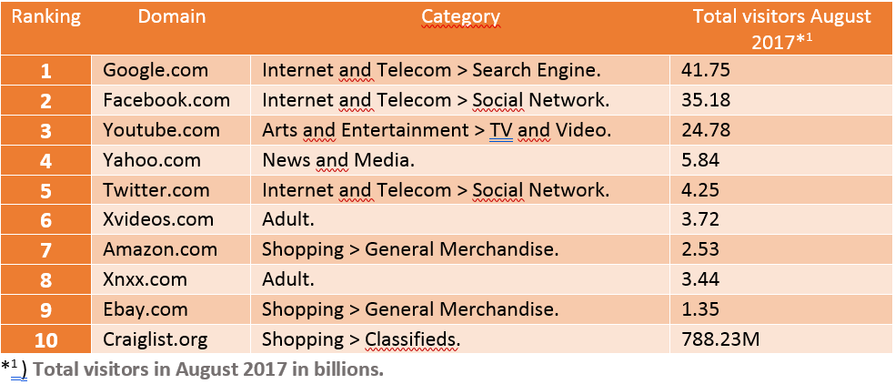
Ten most visited websites

Slide 8
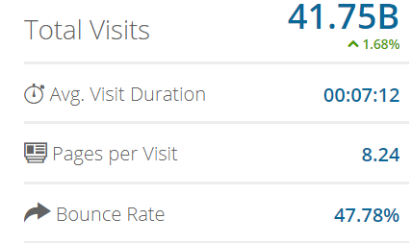

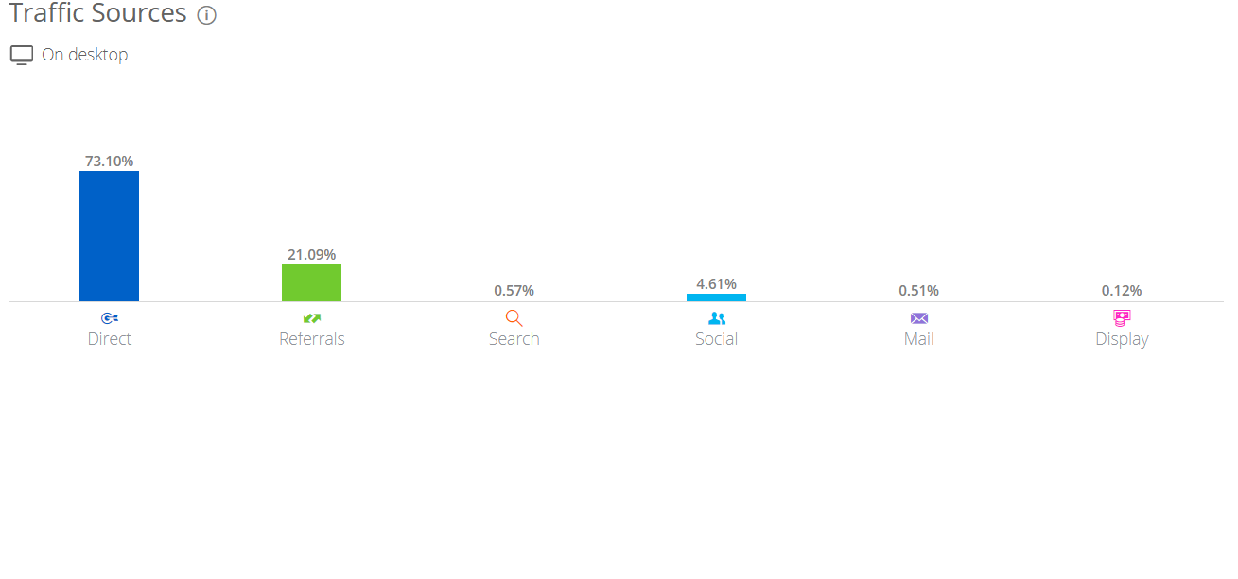
Google.com
Number 2 in global rank.
41.75B visitors in month => August 2017.
Registred at 15 September 1997.

Slide 9

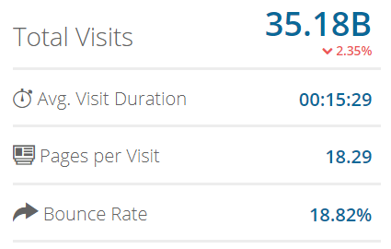
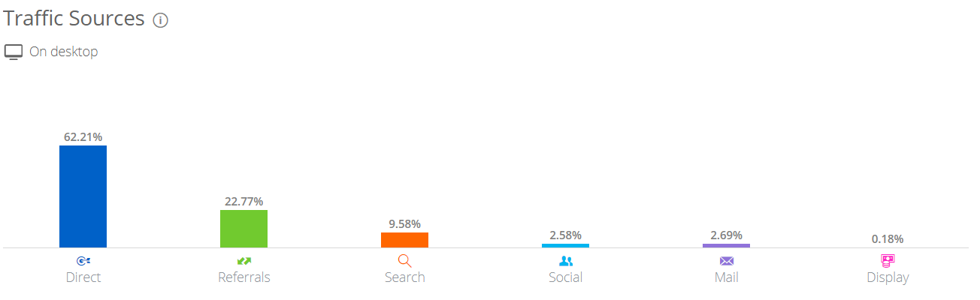
Facebook.com
Number 1 in global rank.
35.18B visitors in month => August 2017.
Registred at 4 February 2004.

Slide 10

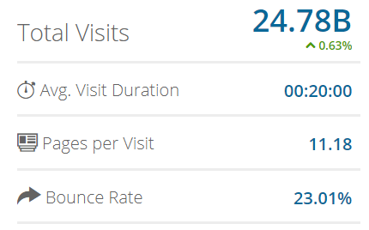
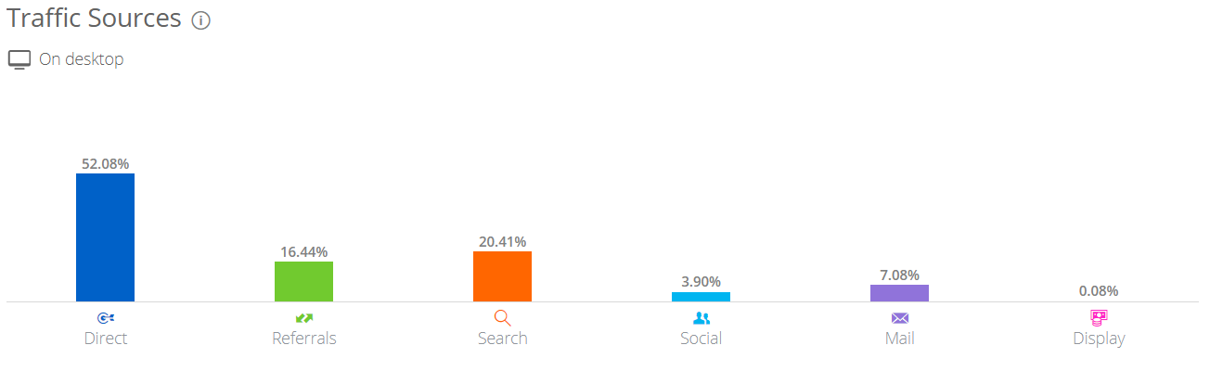
Youtube.com
Number 3 in global rank.
24.78B visitors in month => August 2017.
Registred at February 2015.

Slide 11

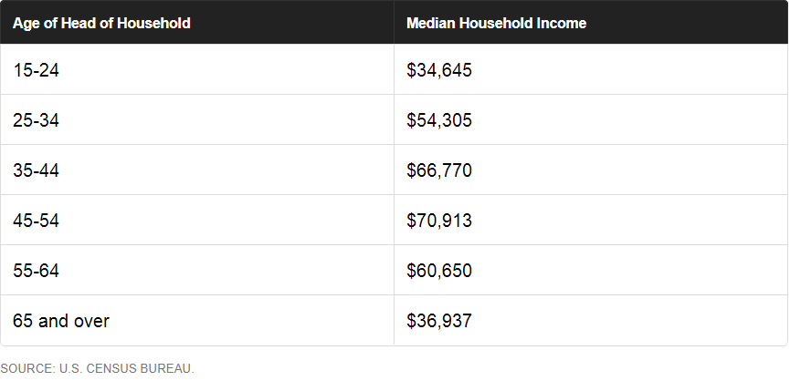
Consumer profile
Total population: 323.127.513
Men: 49.6%
Women: 50.4%
Average age: 37-38
Average household income

Slide 12
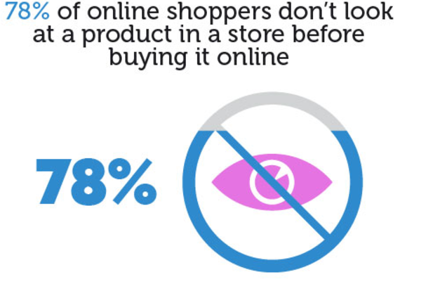
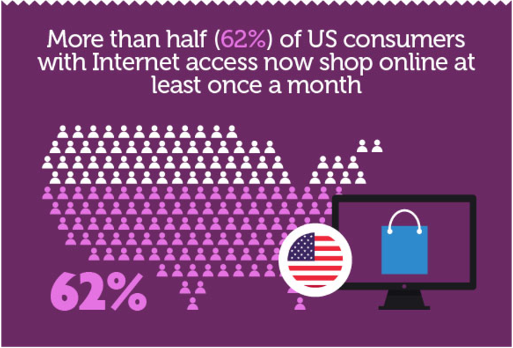
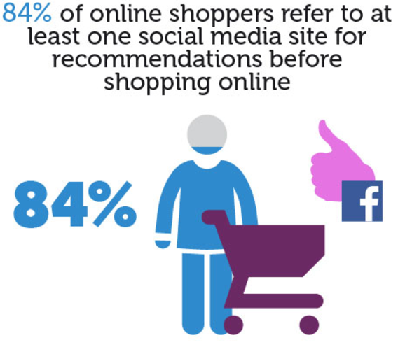
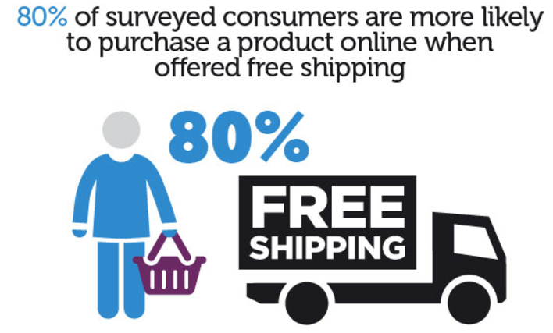
Consumer behaviour

Slide 13
https://docs.google.com/presentation/d/1xYB1Hl8ZuZfDOm5O8C22ytwlDbfvWINx1h0C0Ef2FLk/edit?usp=sharing

Slide 14
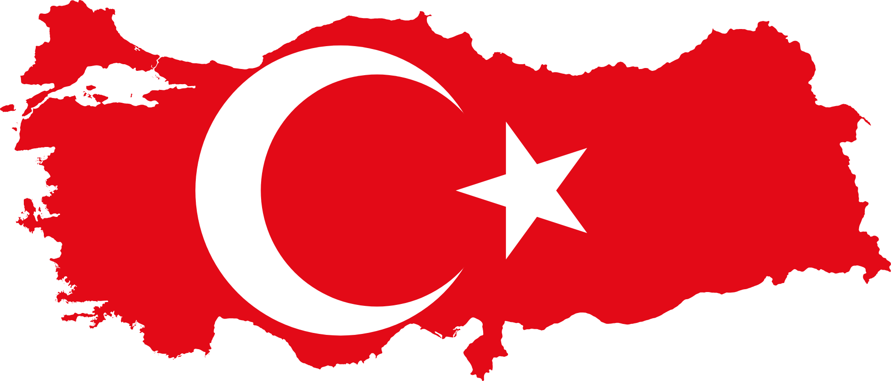

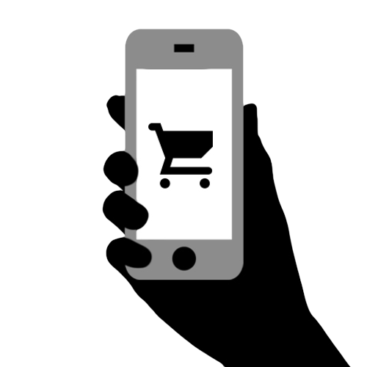

Slide 15
Table of Contents
Customer profile
Most visited websites in 2015
Most visited websites in 2017

Slide 16
Customer Profile
Young people are the major purchasers
Median age of Turkish population is below 29
More than one-quarter of the inhabitants are aged 14 or below
7% of the Turkish population is aged 65 and above
Two-thirds of the population is aged between 15 and 64
Larger household size
three or more children in a household
Preferring economy- or family-size items when buying households items
http://emerging-markets-research.hktdc.com/business-news/article/Turkey/5-2-The-Turkish-consumer-profile.htm
Notes:
Expanding higher-income class
The higher-income class has expanded along with the country’s improving economy in recent years, boding well for the purchasing power of the Turkish market. This is exemplified by the fact that the proportion of households having an annual disposable income of US$25,000-35,000 increased to 15.5% of the total in 2009, compared to only 9.5% in 2004. To cash in on the rising purchasing power in Turkey, many foreign chains such as Carrefour, Metro and Tesco (grocery), Zara and Nine West (fashion), Media Markt and Saturn (consumer electronics) and B&Q and IKEA (DIY and home furnishing) have an increasing presence in major Turkish cities. Hong Kong’s A.S. Watson (a subsidiary of Hutchison Whampoa Limited), has also had a presence in Turkey since 2005, engaging in the retailing of health and beauty products in order to reap the emerging opportunities from rising incomes in the country.
Young people are the major purchasers
While the median age of the Turkish population is below 29, more than one-quarter of the inhabitants in the country are aged 14 or below, leading to a higher demand for children’s toys and child-care articles. Meanwhile, those aged 65 and above account for 7% of the population, and about two-thirds of the population is aged between 15 and 64. While the income of the working class, especially young professionals, has increased along with the growth of the business sector in the past few years, youngsters’ purchasing power, backed by improvements in their parents’ incomes, has also risen. This young consumer group, which has a strong preference for Western-style products and fashionable goods, has become a major purchaser in the market, and hence are the targeted customers of most consumer goods companies.
Larger household size
Turks prefer a larger family than their European counterparts, leading the country to have the highest proportion of households (i.e. 20% according to OECD Family Database) with three or more children across EU and OECD economies. The larger household size has also resulted in consumers preferring economy- or family-size items when buying household items. Also, demand for child-care products is potentially larger than that in Western Europe. But the higher number of children, coupled with their lower incomes, has prompted them to purchase cheaper toy sets, educational products and clothes for their children.
Mature brand culture
Unlike many other emerging markets, there is a mature brand culture among Turkish consumers. Turks, especially those residing in major cities, generally have a good knowledge of both local and reputable foreign brands. Although this does not necessarily mean that Turkish consumers always buy branded products (especially in light of their relatively low incomes), they largely acknowledge that a good brand, rather than a mere trademark, represents quality, offers a warranty and has after-sales services. Therefore, branded products usually enjoy a premium in the market. Even for goods originating from the Chinese mainland, branded goods are well received by consumers.
As for non-branded products, however, consumers will focus on the country of origin. Unfortunately, non-branded products originating from China usually have a poor reputation among Turkish consumers in terms of quality and reliability, and such products are usually meant for the low-end market.

Slide 17
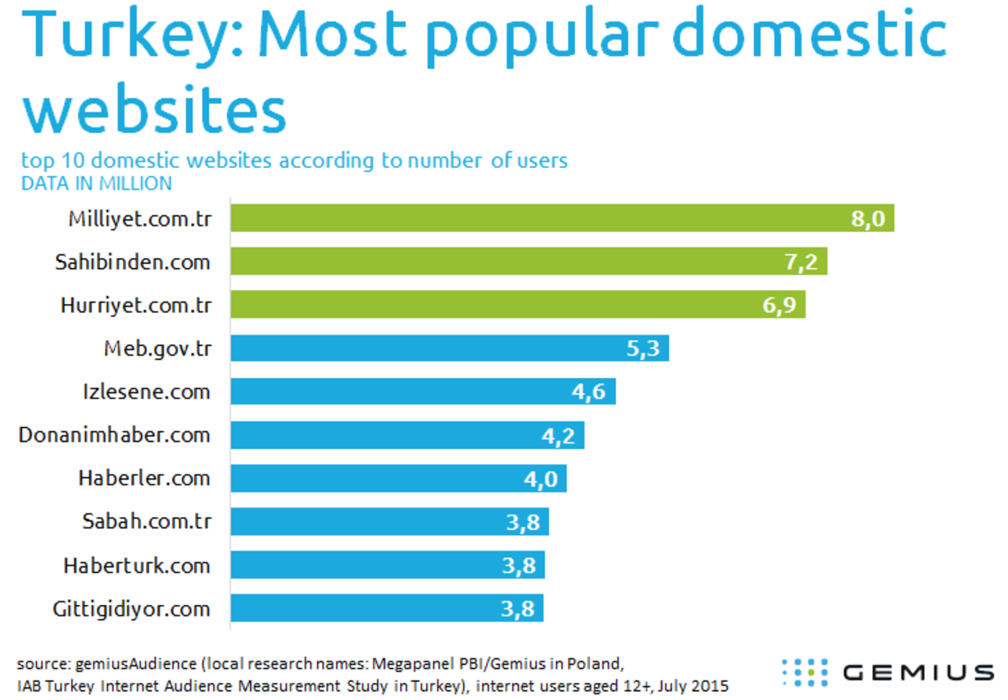
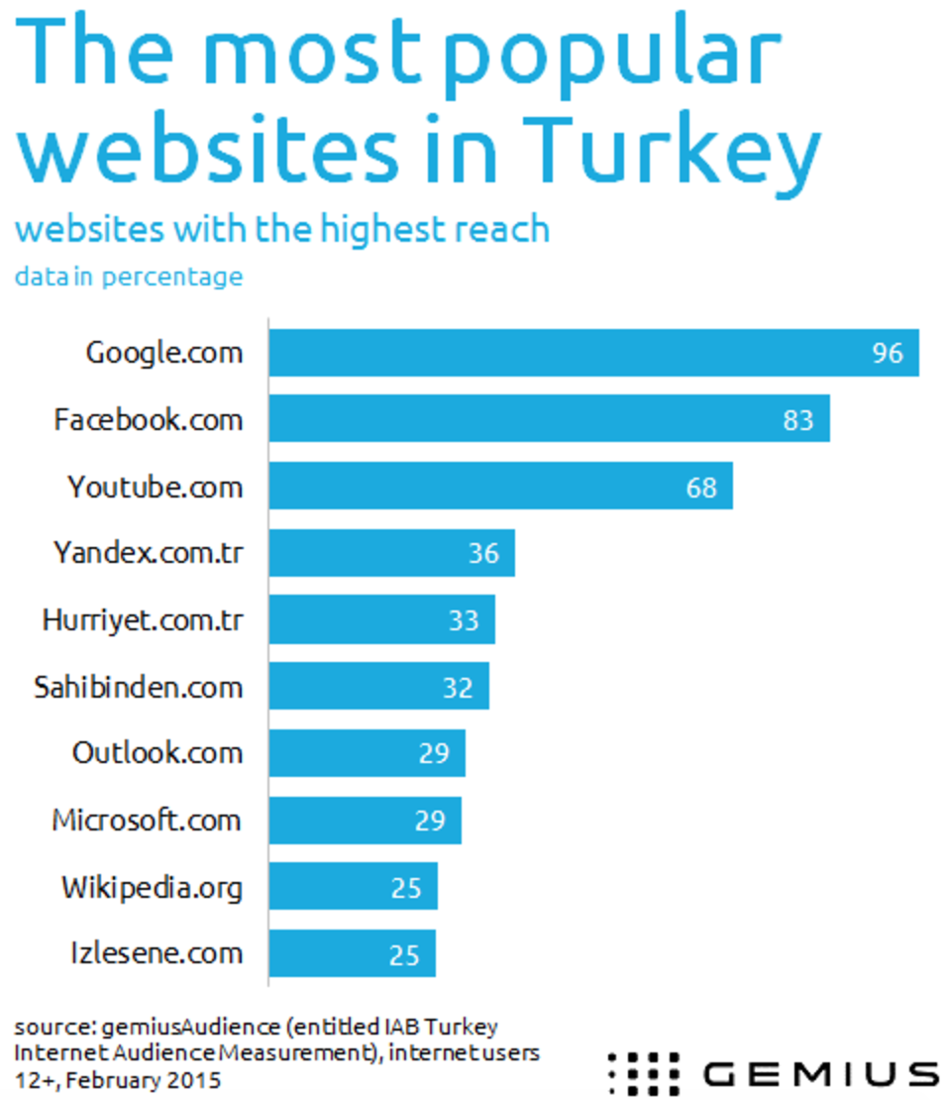
Most visited websites in 2015
Notes:
The lineup shows the 10 most popular domestic websites according to number of visitors. News services are the most popular – there are six in the ranking, led by the popular Milliyet.com.tr. However, the top ten most visited websites also include services offering shopping, entertainment and technology news. Auction services are found in second and tenth position (Sahibinden.com and Gittigidiyor.com). In the remaining two positions are a video service, the Turkish equivalent of YouTube.com (Izlesene.com) and an information and technology news website (Donanimhaber.com).
The most popular Turkish news website Milliyet.com.tr is visited by 8 milion users. What does this mean for digital publishers and agencies? – The digital advertising investment results show an increase of 20 per cent in the mobile, video and display categories, according to the announcement of IAB Turkey for the first six months of 2015 – says İdil Kesten, industry expert and head of the Turkish branch of Gemius.
The most popular websites in Turkey are those of American origin. In February 2015, Google.com was visited by 96 per cent Turkish internet users, Facebook – 83 per cent, and YouTube – 68 per cent.
Google.com and Facebook.com most time consuming
Google.com and Facebook.com were the websites where Turkish internet users spent most of their time – on average, 8 hours every month. In turn, Sahibinden.com had the most page views per month (on average, 357 page views per visitor).

Slide 18
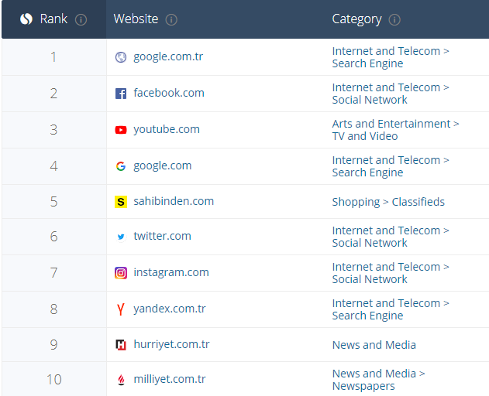
Most visited websites in 2017
According to SimilarWeb
https://www.similarweb.com/top-websites/turkey

Slide 19
About the research
Thanks to Gemius Global
https://www.gemius.com/agencies-news/most-popular-turkish-websites-2491.html
https://www.gemius.com/agencies-news/turkish-internets-most-popular-websites.html
Thanks to SimilarWeb
https://www.similarweb.com/top-websites/turkey
Thanks to Emerging Markets Research
http://emerging-markets-research.hktdc.com/business-news/article/Turkey/5-2-The-Turkish-consumer-profile.htm
Notes:
About the research
The data comes from an international research project conducted by Gemius in over 30 countries in Europe, the Middle East and North Africa (gemiusAudience). It aims to determine the number and demographic profile of internet users and to learn about the ways in which they use the net: websites, audio and video material, or applications. The research is carried out in compliance with the international code of conduct ICC/ESOMAR. In Turkey, the data is gathered from IAB Turkey Internet Audience Measurement Study.

Slide 20
Online marketing
Top 10 most visited websites in Japan
Emre Aydemir 500730246
Redouan el Arbaoui 500739760

Slide 21
Top 10 most visited websites in Japan by number of visitors
Website Category
Google.co.jp Search engine
Yahoo.co.jp News and media
Google.com Search engine
Youtube.com TV and Video
Twitter.com Social network
Amazon.co.jp Shopping
Facebook.com Social network
Fc2.com Web Hosting
Rakuten.co.jp Shopping
Docome.ne.jp Telecommunications

Slide 22
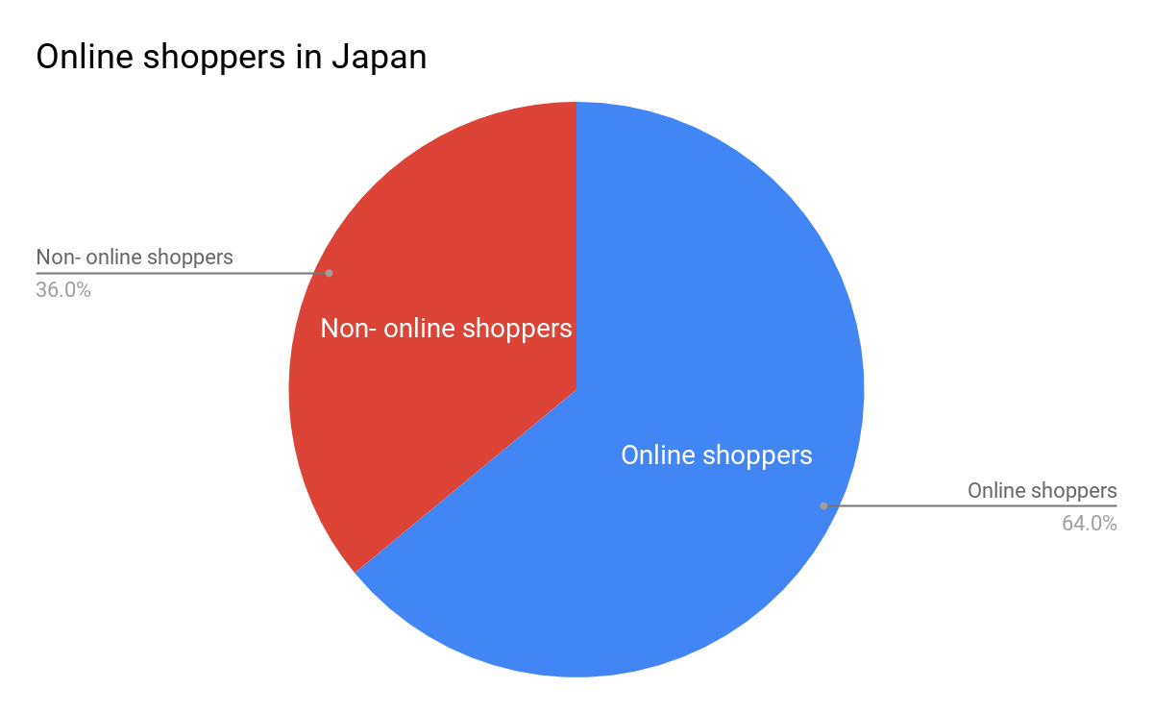
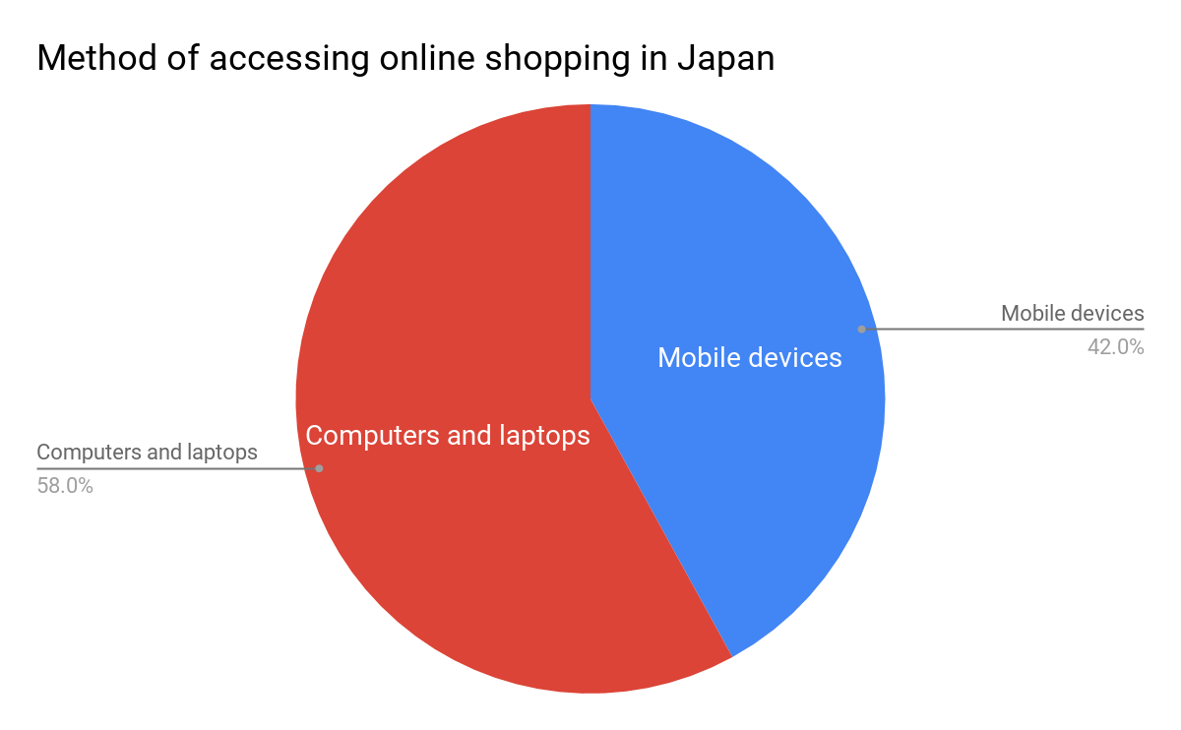
Online shopping in Japan
98% of the Japanese population is online (Total population: 126,958,000)
Total revenue: 88 billion USD (#4 in the world)

Slide 23
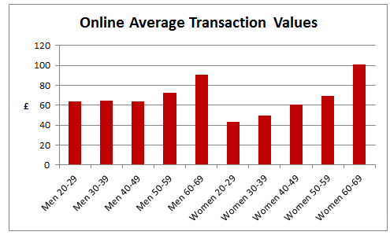
Online consumer profile
Two reasons why
Price
Convenience

Slide 24
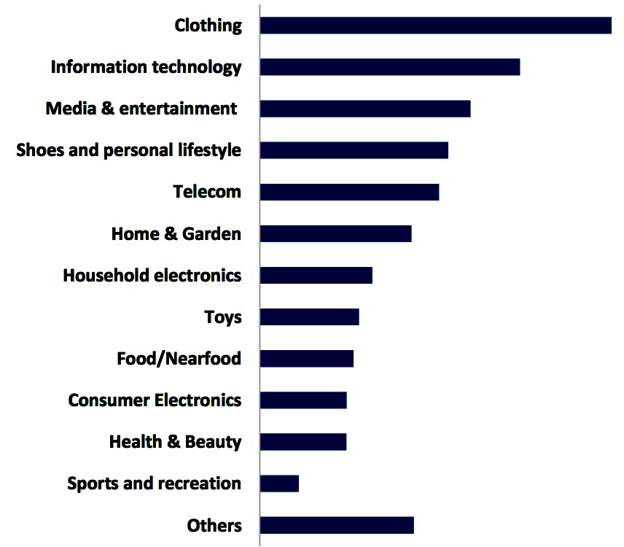
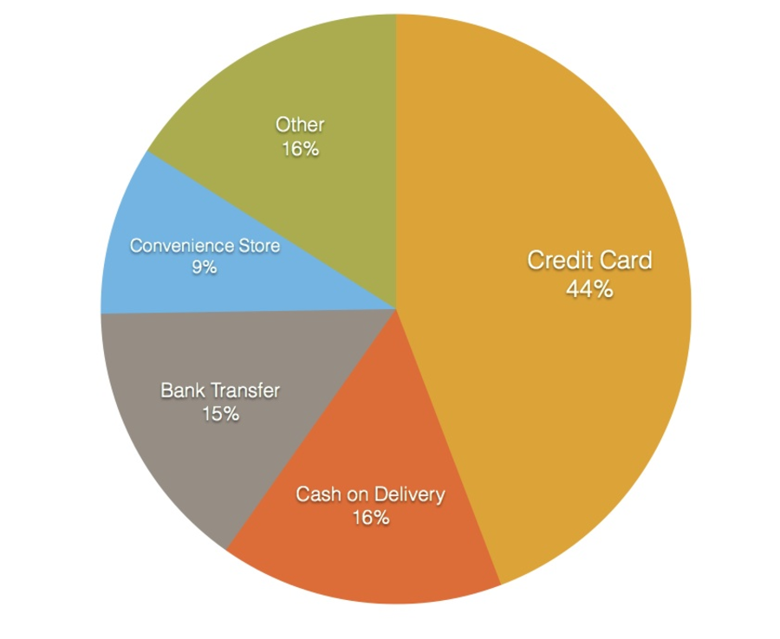
What they buy online & the payments methods

Slide 25
Sources
https://www.similarweb.com/top-websites/japan
http://www.agr.gc.ca/resources/prod/Internet-Internet/MISB-DGSIM/ATS-SEA/PDF/6807-eng.pdf
https://www.linkedin.com/pulse/japanese-consumer-mindset-philippe-huysveld-ir-mba
http://blog.btrax.com/en/2016/12/07/who-shops-online-more-in-japan-younger-or-older-people/
http://blog.btrax.com/en/2014/09/05/sell-online-in-japan-ecommerce/
http://www.mckinsey.com/industries/consumer-packaged-goods/our-insights/the-new-japanese-consumer
https://www.datocms-assets.com/2580/1498859756-japan_b2c_e-commerce_report_2016.pdf

Slide 26
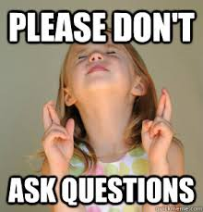
Questions?

Slide 27
Top-10 UAE
Mattijs van Houten, Romen Klaassen and Tereza Urbanová

Slide 28
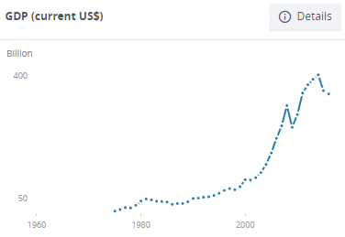
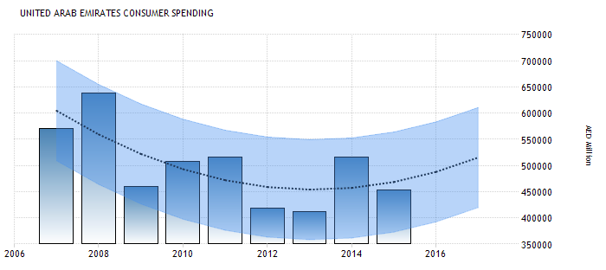
Customer Profile
Online sales non-consumable products doubled (2011-2014)
Holiday & Entertainment
Top 3:
Airline ticket/reservations: 57%
Tours/hotel reservations: 48%
Event tickets: 43%
tradingeconomics.com
gulfnews.com
data.worldbank.org

Slide 29
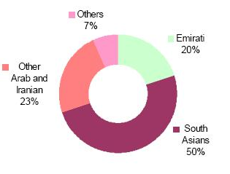
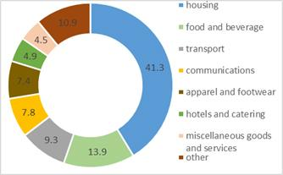
More about customers
- growth of rich customers - luxury segment
-> cars, consumer electronics, cosmetics and perfume and healthcare services
- important preferences:
- Arabic-language packaging
- sensitive to local traditions and religious beliefs
- big differences between high and low-income populations

Slide 30

Overview
semrush.com
Based on visitors (from UAE) in August 2017:
Google.ae (49,9M), Combined with Google.com = 73,3M
Youtube.com (42,4M)
Facebook.com (8,6M)
Yahoo.com (6,7M)
Live.com (3,3M)
Wikipedia.org (2,8M)
Souq.com (2,8M)
Starzplay.com (2,7M)
Dubizzle.com (2M)
Popads.net (1,8M)

Slide 31
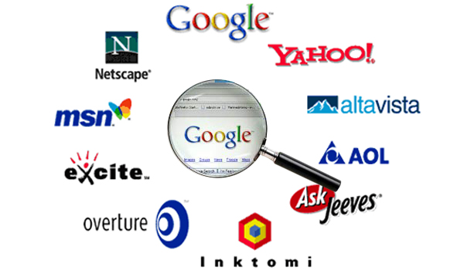
Search
similarweb.com
Percentage of traffic from search (any search engine):
Google.ae (0,21%)
Youtube.com (20,21%)
Facebook.com (9,58%)
Yahoo.com (13,55%)
Live.com (13,94%)
Wikipedia.org (85,32%)
Souq.com (23,4%) - #1 e-commerce company
Starzplay.com (1,82%)
Dubizzle.com (30,66%)
Popads.net (0,74%)

Slide 32

Online Customer Profile
Brazil
Davey | Rick | Stella

Slide 33
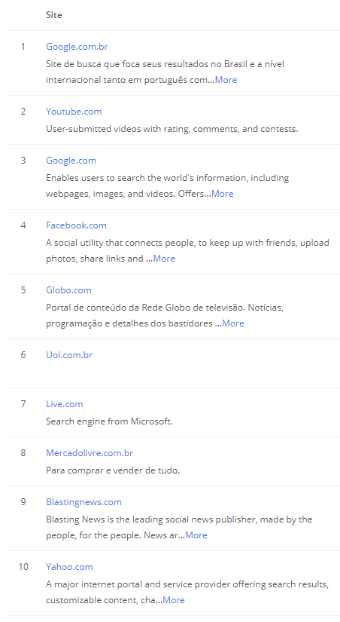
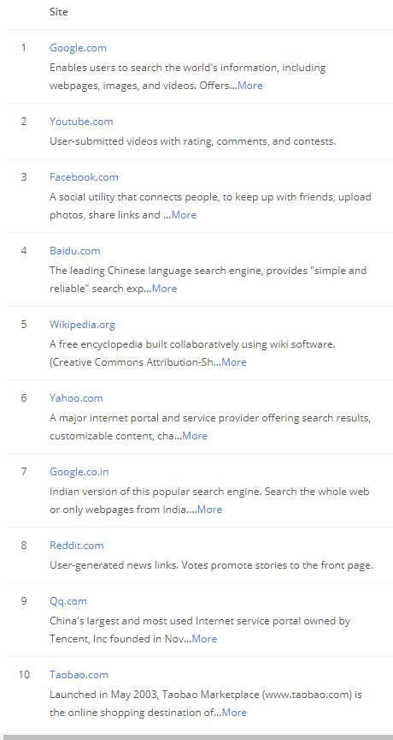

Top 10 most visited Websites Brazil vs Global
Notes:
Source: alexa.com 24-9-2017
A site’s ranking is based on a combined measure of Unique Visitors and Pageviews. Unique Visitors are determined by the number of unique Alexa users who visit a site on a given day. Pageviews are the total number of Alexa user URL requests for a site.

Slide 34
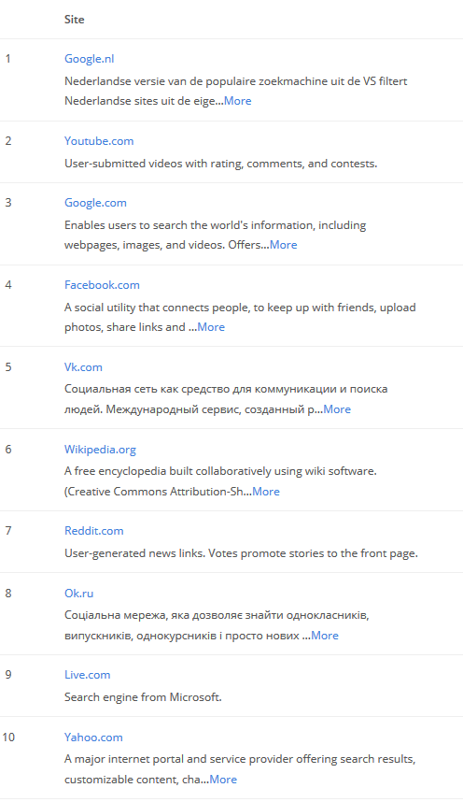
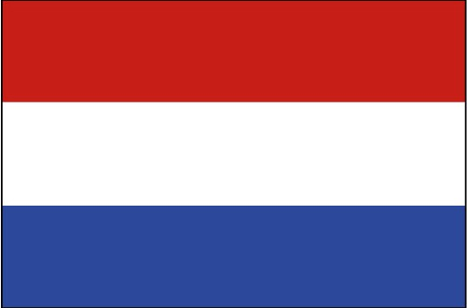
Top 10 most visited Websites Brazil vs Netherlands

Slide 35
Our definition of Customer Profile
“A description of a customer or set of customers that includes demographic, and pshychographic characteristics, as well as their buying patterns.– businessdictionary.com
Demographic, pshychographic characteristics
01
Buying patterns
02
Notes:
20 Questions to create a Customer Profile:
-What is their gender?
-What is their age or age range?
-What is their family background?
-What is their cultural background?
-What is their educational background?
-Where do they live and work?
-Married, single or living with a partner?
-Do they have children?
-How old are their children?
-Do they have children still living at home?
-What sort of place are they living?
-What films and books do they enjoy?
-What is their business or job?
-What are their passions or interests?
-Do they have a common religious ort spiritual belief?
-What do they do in their spare time?
-Where are they on the corporate ladder?
-What is their approximate income?
-What keeps them up at night?
-What are their dreams?

Slide 36
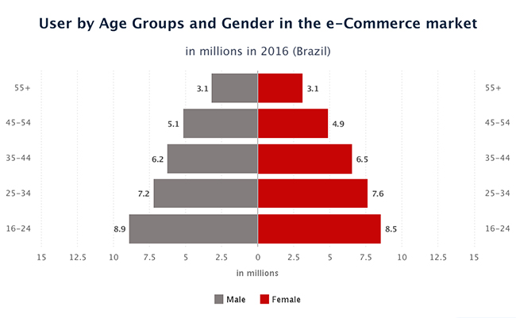
Demographic and pshychographic characteristics
Demographic: Attributes related to age, city or region of residence, gender, race and ethnicity, and composition of household.
Psychographics: Attributes related to lifestyles, life stage, personality, attitudes, opinion, and even voting behavior.
Geographical Region
Southeast: 64.5%
South: 13.7%
Northeast: 12.9%
Central-west: 6.1%
North 2.8%
Notes:
Demographic: Attributes related to age, city or region of residence, gender, race and ethnicity, and composition of household.
Psychographics: Attributes related to lifestyles, life stage, personality, attitudes, opinion, and even voting behavior.
(source: https://www.thebalance.com/consumer-profile-defining-the-ideal-customer-2296932)
(Information source: http://www.eshopworld.com/blog-articles/brazil-ecommerce-insights/)

Slide 37
Buying patterns
Buying pattern: Typical manner in which consumers purchase goods or services (or firms place their purchase orders) in terms of amount, frequency, timing, etc.
Average cart price (2016): US$126.3 (R$417) | 8% growth
54 percent of Brazilian buyers purchased on international websites in 2016. Increase of 17 percent compared to 2015. Increase of 38 percent compared to 2014!
90 percent of Brazilians’ online purchases are made through Brazilian payment methods.
Source: Brazil Chamber of Electronic Commerce
E-bit
Statista
ABComm
Notes:
Buying pattern: Typical manner in which consumers purchase goods or services (or firms place their purchase orders) in terms of amount, frequency, timing, etc.
(source: http://www.businessdictionary.com/definition/buying-pattern.html)
The average e-Commerce purchase (average cart price) in Brazil for 2016 was US$126.3 (R$417), 8 percent higher than the previous year. This number is projected to reach US$137 (R$452) in 2017. It is also estimated that the number of purchases will increase 3.5 percent in 2017, and will reach a total of 110 million purchases made online. The increase in sales in virtual stores in the country is due to new consumption habits of the population. The migration of purchases from physical retail to electronic commerce is a factor that will continue to contribute to increased sales. We estimate that in 2017 e-Commerce sales will account for approximately 4.3 percent of retail sales in Brazil, compared to 3.8 percent in 2016. The most profitable industry sectors for online shopping include electronic appliances, computers, electronics, fashion, cosmetics, household appliances, and home decoration. Fashion is a particularly interesting category, due to the widely held belief that Brazilians need to try on clothes before purchasing.
Current Market Trends Mobile commerce continues to be one of the strongest trends for 2017. Consumers are learning to compare prices and product information via the Internet and often prefer the convenience of purchasing items via e-Commerce. The rise in sales of mobile devices (2 percent), compared to the decrease in sales of notebooks (30 percent) and desktops (37 percent) demonstrates a change in people’s lifestyle and buying habits.
Brazilians tend to purchase through marketplaces and group buying websites. Brazilians also like to take advantage of online discount websites and coupons. Many middle-class consumers are aware that online prices for consumer goods and customer service policies are better than in stores.
Domestic e-Commerce (B2C)
The one factor enabling the development of the business-to-consumer (B2C) sector is the “long-tail” effect, which allows a wider product offering in niche areas compared to that found in physical storefronts. Surveys held in other countries, for example, indicate that online stores’ inventories are 6 to 23 times larger than those of physical stores. Retailers are taking advantage of U.S. selling techniques to increase purchases. For example, Brazilian stores (both physical and online) offer Black Friday discounts. Black Friday (2016) in Brazil, generated e-Commerce sales of US$575.7 million (R$1.9bi) which broke all previous sales records for a single day. In total, 1.64 million e-consumers made at least one purchase within 24 hours of Black Friday.
Cross Border e-Commerce
Research published by eBit shows that in 2016 Brazilian e-consumers spent US$2.4 billion in cross-border websites, which represents an increase of 17 percent compared to 2015 and 38 percent compared to 2014. It finds that 54 percent of Brazilian buyers purchased on international websites in 2016. The research also shows that despite the devaluation of the Brazilian currency compared to the dollar in 2016, each e-consumer made 3.7 purchases in cross-border sites, while in 2015 the rate was 3.8. This could be for several possible reasons including increases of international purchases by Brazilians outside the United States. On domestic sites, the average was 2.2 purchases. The average ticket price in cross-border sites decreased 27 percent from 2014 to 2015 and remained stabled in 2016.
Studies demonstrate that four out of 10 Brazilians completed a purchase on an international website over the last year and the figures continue to grow. Chinese websites are very popular among Brazilian shoppers. According to eBit research, the top five most used international websites in order are AliExpress (45 percent of consumers), Amazon.com (40 percent), eBay (26 percent), DealExtreme (12 percent) and Apple Store (10 percent).
Online Payment According to PagBrasil, 90 percent of Brazilians’ online purchases are made through Brazilian payment methods, although the country's online payments market is restricted. In addition, domestic payment solutions are more cost effective since they save the 6.38 percent IOF tax, which is applied to all international transactions. Brazilian credit cards issued by local banks are limited to payments in Brazilian Reais (hey-EYES). U.S. companies selling in Brazil need to offer ways to pay using Brazilian credit cards and be able to convert currency. Another payment method in Brazil is the Boleto Bancário (payment slip), essentially a payment receipt issued through a bank. This is most often used for Brazilians who do not have a credit card and for B2B payments because it allows companies to avoid costly wire transfer fees, according to Allpago. One of the drawbacks to Boleto is that the payment confirmation is delayed and can take up to three business days. Companies like Paypal are growing in popularity but will still take some time to be mainstream.
Payment methods are complex and varied in nature. 62 percent of online consumers used credit cards, 28 percent used Paypal, while nine percent used payment slips (Boleto). Security continues to be a concern especially regarding online fraud. International transactions can be challenging for residents and visitors alike. While visitors have relatively few problems using credit cards at hotels and tourist venues, the same is not true for online purchases. The majority of Brazilians do not carry international credit cards. Those wishing to pay for services such as airline or movie tickets online encounter barriers, as many Brazilian websites do not accommodate international credit cards. The most commonly accepted cards in Brazil are Visa and MasterCard with chip and PIN technology.
Social Media
In 2013, the Wall Street Journal bestowed Brazil with the title of “Social Media Capital of the Universe.” Social media is the ideal way for U.S. companies to market to Brazilian marketers. Brazilian users are among the world's most engaged, spending an increasing amount of time on social media. Over 100 million Brazilians use some type of social media on a daily basis. Facebook and WhatsApp are the leading social networks in the country, followed by Facebook Messenger, Instagram, and Twitter. For social media marketers targeting Brazil, this popularity opens up unprecedented opportunities. For U.S. companies targeting Brazil, it is important to understand the importance of social media.
Major Buying Holidays
Brazil has five holidays where retail sales increase: 1 – Christmas 2 – Mother’s Day (second Sunday in May) 3 – Valentine’s Day (June 12) 4 – Father’s Day (second Sunday in August) 5 – Easter There are four other dates where retail sales also grow: Carnival (holiday), Children’s Day (commemorative date), Black Friday, and Cyber Monday.
(source: https://www.export.gov/article?id=Brazil-e-Commerce)

Slide 38
Buying patterns
Buying pattern: Typical manner in which consumers purchase goods or services (or firms place their purchase orders) in terms of amount, frequency, timing, etc.
The rise in sales of mobile devices (2 percent), compared to the decrease in sales of notebooks (30 percent) and desktops (37 percent) demonstrates a change in people’s lifestyle and buying habits.
Over 100 million Brazilians, 50% use some type of social media on a daily basis.
Major Buying Holidays 1 – Christmas 2 – Mother’s Day (second Sunday in May) 3 – Valentine’s Day (June 12) 4 – Father’s Day (second Sunday in August) 5 – Easter Carnival (holiday), Children’s Day (commemorative date), Black Friday, and Cyber Monday.
Source: Brazil Chamber of Electronic Commerce
E-bit
Statista
ABComm
Notes:
Buying pattern: Typical manner in which consumers purchase goods or services (or firms place their purchase orders) in terms of amount, frequency, timing, etc.
(source: http://www.businessdictionary.com/definition/buying-pattern.html)
The average e-Commerce purchase (average cart price) in Brazil for 2016 was US$126.3 (R$417), 8 percent higher than the previous year. This number is projected to reach US$137 (R$452) in 2017. It is also estimated that the number of purchases will increase 3.5 percent in 2017, and will reach a total of 110 million purchases made online. The increase in sales in virtual stores in the country is due to new consumption habits of the population. The migration of purchases from physical retail to electronic commerce is a factor that will continue to contribute to increased sales. We estimate that in 2017 e-Commerce sales will account for approximately 4.3 percent of retail sales in Brazil, compared to 3.8 percent in 2016. The most profitable industry sectors for online shopping include electronic appliances, computers, electronics, fashion, cosmetics, household appliances, and home decoration. Fashion is a particularly interesting category, due to the widely held belief that Brazilians need to try on clothes before purchasing.
Current Market Trends Mobile commerce continues to be one of the strongest trends for 2017. Consumers are learning to compare prices and product information via the Internet and often prefer the convenience of purchasing items via e-Commerce. The rise in sales of mobile devices (2 percent), compared to the decrease in sales of notebooks (30 percent) and desktops (37 percent) demonstrates a change in people’s lifestyle and buying habits.
Brazilians tend to purchase through marketplaces and group buying websites. Brazilians also like to take advantage of online discount websites and coupons. Many middle-class consumers are aware that online prices for consumer goods and customer service policies are better than in stores.
Domestic e-Commerce (B2C)
The one factor enabling the development of the business-to-consumer (B2C) sector is the “long-tail” effect, which allows a wider product offering in niche areas compared to that found in physical storefronts. Surveys held in other countries, for example, indicate that online stores’ inventories are 6 to 23 times larger than those of physical stores. Retailers are taking advantage of U.S. selling techniques to increase purchases. For example, Brazilian stores (both physical and online) offer Black Friday discounts. Black Friday (2016) in Brazil, generated e-Commerce sales of US$575.7 million (R$1.9bi) which broke all previous sales records for a single day. In total, 1.64 million e-consumers made at least one purchase within 24 hours of Black Friday.
Cross Border e-Commerce
Research published by eBit shows that in 2016 Brazilian e-consumers spent US$2.4 billion in cross-border websites, which represents an increase of 17 percent compared to 2015 and 38 percent compared to 2014. It finds that 54 percent of Brazilian buyers purchased on international websites in 2016. The research also shows that despite the devaluation of the Brazilian currency compared to the dollar in 2016, each e-consumer made 3.7 purchases in cross-border sites, while in 2015 the rate was 3.8. This could be for several possible reasons including increases of international purchases by Brazilians outside the United States. On domestic sites, the average was 2.2 purchases. The average ticket price in cross-border sites decreased 27 percent from 2014 to 2015 and remained stabled in 2016.
Studies demonstrate that four out of 10 Brazilians completed a purchase on an international website over the last year and the figures continue to grow. Chinese websites are very popular among Brazilian shoppers. According to eBit research, the top five most used international websites in order are AliExpress (45 percent of consumers), Amazon.com (40 percent), eBay (26 percent), DealExtreme (12 percent) and Apple Store (10 percent).
Online Payment According to PagBrasil, 90 percent of Brazilians’ online purchases are made through Brazilian payment methods, although the country's online payments market is restricted. In addition, domestic payment solutions are more cost effective since they save the 6.38 percent IOF tax, which is applied to all international transactions. Brazilian credit cards issued by local banks are limited to payments in Brazilian Reais (hey-EYES). U.S. companies selling in Brazil need to offer ways to pay using Brazilian credit cards and be able to convert currency. Another payment method in Brazil is the Boleto Bancário (payment slip), essentially a payment receipt issued through a bank. This is most often used for Brazilians who do not have a credit card and for B2B payments because it allows companies to avoid costly wire transfer fees, according to Allpago. One of the drawbacks to Boleto is that the payment confirmation is delayed and can take up to three business days. Companies like Paypal are growing in popularity but will still take some time to be mainstream.
Payment methods are complex and varied in nature. 62 percent of online consumers used credit cards, 28 percent used Paypal, while nine percent used payment slips (Boleto). Security continues to be a concern especially regarding online fraud. International transactions can be challenging for residents and visitors alike. While visitors have relatively few problems using credit cards at hotels and tourist venues, the same is not true for online purchases. The majority of Brazilians do not carry international credit cards. Those wishing to pay for services such as airline or movie tickets online encounter barriers, as many Brazilian websites do not accommodate international credit cards. The most commonly accepted cards in Brazil are Visa and MasterCard with chip and PIN technology.
Social Media
In 2013, the Wall Street Journal bestowed Brazil with the title of “Social Media Capital of the Universe.” Social media is the ideal way for U.S. companies to market to Brazilian marketers. Brazilian users are among the world's most engaged, spending an increasing amount of time on social media. Over 100 million Brazilians use some type of social media on a daily basis. Facebook and WhatsApp are the leading social networks in the country, followed by Facebook Messenger, Instagram, and Twitter. For social media marketers targeting Brazil, this popularity opens up unprecedented opportunities. For U.S. companies targeting Brazil, it is important to understand the importance of social media.
Major Buying Holidays
Brazil has five holidays where retail sales increase: 1 – Christmas 2 – Mother’s Day (second Sunday in May) 3 – Valentine’s Day (June 12) 4 – Father’s Day (second Sunday in August) 5 – Easter There are four other dates where retail sales also grow: Carnival (holiday), Children’s Day (commemorative date), Black Friday, and Cyber Monday.
(source: https://www.export.gov/article?id=Brazil-e-Commerce)

Slide 39
Questions?
Or any feedback is appreciated.

Slide 40
https://docs.google.com/presentation/d/1Y_Cd96yilKfYbF49UbK80uWOps4out2BceGs1Jr31mw
https://docs.google.com/presentation/d/1UnuEbvFu0SV_T2laYaps_E50XWF7Zr6mBTDz9RNTOis/edit#slide=id.p

